Slide 1
Learning QBITS
Dr. Bhawana Rudra
NITK

Slide 2
QBIT Notations
The 0 qubit can be written as |0 > and 1 can be written as |1 > , which are called ket 0 and ket 1 respectively.
bra 0 and bra 1 can be written as < 0| and < 1| which denotes the conjugate transpose of the ket 0 and ket 1 respectively

Slide 3
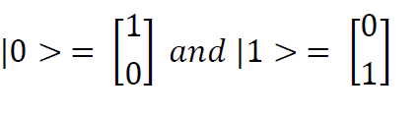

We can see ket representation of qubits as follows:
The bra notation is as follows:

Slide 4
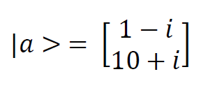

If the states contain complex values then the bra will be a complex conjugate of the ket.
let's consider an example. Let's define a ket state to be complex:
The bra of a becomes as follows:

Slide 5
The notation <a|b> gives the inner product of the two quantum states, which is a scalar value
The notation |a><b| gives the outer product of the two quantum states, which is a matrix.
The various states of the qubit live in a complex vector space known as the Hilbert space.

Slide 6

Superposition of qubits
This phenomenon of qubits living in complex linear combinations of quantum states is known as superposition and has huge significance in quantum computing.
This is one of the fundamental properties of quantum computing that makes it so powerful in carrying out computational tasks that classical computers cannot perform.
The superposition property gives quantum computers the power to perform computations in a parallel manner.
It is because of superposition that quantum computers are inherently parallel and don't require separate parallel architecture to achieve parallel computing tasks, as we usually do with Graphics Processing Units (GPUs).
A generic superposition quantum state is defined as follows:

Slide 7

Where 𝛼 and 𝛽 are complex numbers that are known as probability amplitudes, and the qubits |0 > and |1 > are said to be in a state of superposition.
Since the qubits are in a state of superposition, it means that there is a certain probability of the |0 > state occurring, just as there is a certain probability of |1 > occurring.
To calculate the probabilities, we take the modulus (absolute value) of the probability amplitude value associated with the qubit and then square it.
Therefore, |𝛼|2 gives us the probability of finding the state |0 > and |𝛽|2 gives us the probability of finding the state |1 > when they occur in superposition.
Since |𝛼|2 and |𝛽|2 gives us the probabilities, they add up to 1:

Slide 8
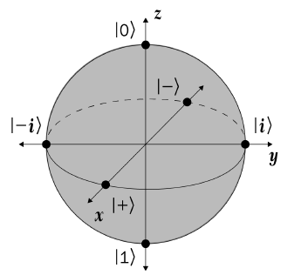
Bloch Sphere
The Bloch sphere is a 3D geometric representation of a qubit, and it helps us to visualize the quantum states that a qubit can take.
It has a unit radius and we can use vector notation to denote the quantum states.
The Bloch sphere is only valid for a single qubit
because when there is more than one qubit,
the dimensions exceed the drawing capacity.
This diagram will help you to visualize the
Various single-qubit operations that can be performed:

Slide 9
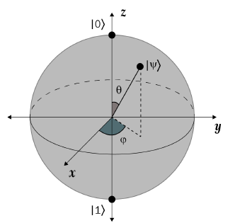
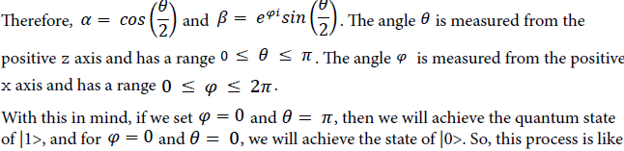
The angles 𝜃 and 𝜑 clearly, and you can then observe that various quantum states can be formed if these angles are set to certain values:

Slide 10


moving away from the superposition state that is present in the Bloch sphere towards various points present on the surface of the sphere.
It is important to note that since the absolute value (modulus) of a complex amplitude is always 1, so even if a complex valued
amplitude is multiplied by a certain quantum state, it doesn't change the state at all.
An interesting fact to note here is that we can write the states |0> and |1> in terms of the other basis state representations. The following equation for |0> demonstrates this:
For state |1>, it is as follows:

Slide 11
Introducing quantum measurements
In quantum computing, whenever we start talking about making measurements, we are referring to the fact that the quantum system is interacting with the environment.
Whenever qubits interact with an external environment, the phenomenon of decoherence takes place and they no longer maintain their quantum properties, which severely alters their quantum state.
This configuration is what we describe as an open system, where the qubits interact with the environment and the time evolution is not inflexible.
The process of measurement can only take place in an open system because the measurement device has to interact with the quantum system and states to extract information from it.
After the measurement process, the whole quantum system is severely altered and disturbed.

Slide 12
During the measurement process, a phenomenon known as the collapse of the wave function occurs.
Prior to measurement of the quantum system, the quantum system lives in the superposition of the basis states but as soon as a measurement is taken, the superposition collapses to a single basis state that corresponds to the result of the measurement.
The measurement operation is thus irreversible.
The process of carrying out a measurement involves the selection of a basis state in which we want to perform the measurement and then choosing which measurement to perform.
This means that if you choose the Z basis states, then your measurement will either be |0> or |1>.
This means that the states |0> and |1> will be the same but their coordinates will no longer be [1 0] and [0 1] respectively. Their coordinates will depend on the particular orthonormal basis state chosen. The Z basis is also known as the energy basis because the basis states also correspond to the qubit energy levels.
So, if we choose to measure |0> or |1> in the Z basis state, we will get them with 1.0 probability.
The scenario becomes different when we want to measure a |−> in the Z basis state.
Since we know that for |−> , states |0> and |1> both occur with 0.5 probability, so after measurement also we get the same results. This means if identical |−> states are prepared 200 times, then around 100 of them will be |0> and the rest will be |1>.
Also, if we measure a certain superposition of quantum states and get a particular basis state, then no matter how many times we measure that superposed quantum state, we are going to get that same basis state. This means that if you measure |−> and get |0> after measurement, then if you again measure |−> you will still keep getting |0> as the output.

Slide 13


The X basis states — |+> and |−>
The X basis states are also known as diagonal basis or Hadamard basis states, and theyare equal superpositions of the |0> and |1> states. Here is their mathematical description
You can clearly observe that in both states, the probability of finding state

Slide 14

The Y basis states – |𝒊 > and | − 𝒊>
The Y basis states are also known as the circular basis, and even they form equal superposition similar to Z basis states but possess complex amplitudes. Let's take a look at their mathematical equations:
If you look carefully, you will see that the probability of finding the
|0 > and |1 > states is ½ and the presence of the complex phase does not create any effects. Sometimes Y basis states are also denoted by | ↻> and | ↺> , which are known as clockwise and counterclockwise basis states.

Slide 15

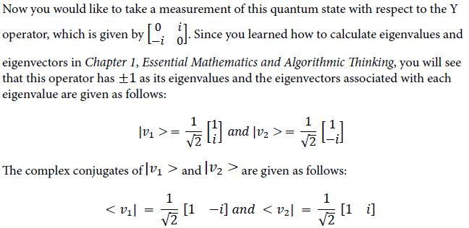
Let's assume that you are provided a quantum state:

Slide 16
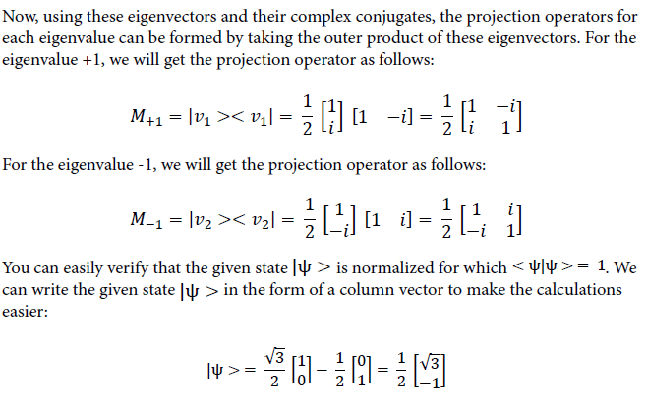

Slide 17
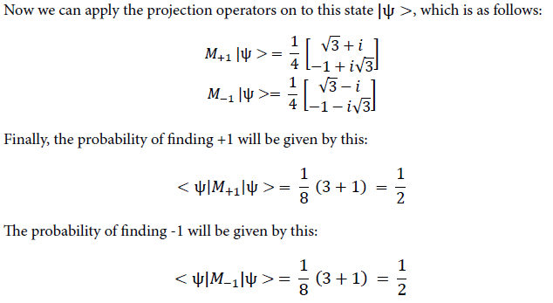

Slide 18
Quantum logic gates
One of the most important properties of quantum logic gates is that they are all unitary, which means they are reversible and there is no loss of information.
All the gates preserve the complex vector space transformations, which means if you apply a 𝜋 rotation in the X axis of the Bloch sphere to reach the state |1> from |0>,
Then the complex conjugate of the gate will help you to reverse the transformation that you did to the Bloch sphere, which means you will return to state |0>.
This means there is no loss of information, and from the output of the quantum gates you will be able to find out the inputs as well.

Slide 19
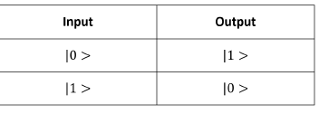
Pauli gates
Pauli gates are named after the physicist Wolfgang Pauli, who received a Nobel Prize in Physics in 1945. There are three Pauli gates – X, Y, and Z gates – and you will see that they correspond to the different basis representations we saw in the Bloch sphere.
It is important to note that all the Pauli gates are Hermitian. Let's start with the X gate.
The Pauli X gate
The Pauli X gate is analogous to the classical NOT gate. Whenever this gate is applied to a qubit, it flips that qubit.
If you think about this in terms of the Bloch sphere, then the X gate applies a 𝜋 (180°) rotation about the x axis, which flips the qubit.

Slide 20
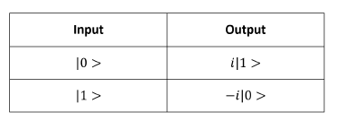
The Pauli Y gate
The Pauli Y gate, as you might have guessed already, applies a 𝜋 (180°) rotation around the y axis of the Bloch sphere, which also flips the bit but multiplies a complex amplitude with the output state, which doesn't have an impact on the output state.

Slide 21
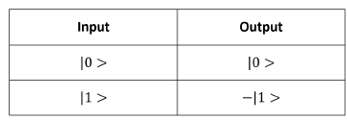
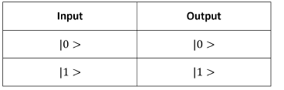
The Pauli Z gate
The Pauli Z gate applies a 𝜋(180°) rotation to the input state around the z axis of the Bloch sphere, which creates a phase shift operation. This gate is also known as the phase shift gate or the phase flip gate and is used in a lot of quantum algorithms.
The Pauli I gate
The Pauli I gate, which is also known as the identity gate, is an operator that's useful for proving the unitary nature of the quantum gates and for the measurement of decoherence in qubits. When it is applied to any qubit, it does not change its state.

Slide 22
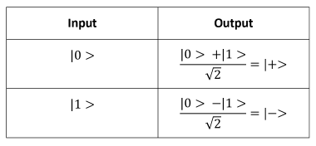
The Hadamard gate – the quantum H gate
The Hadamard gate is one of the most important quantum gates you will learn about because it is used in almost all quantum algorithms to create an equal superposition of qubits.
This gate is named after Jacques Hadamard and creates a complex linear superposition of two basis states when it is applied to a particular quantum state.
Theoperation of the H gate rotates the input qubit along the z and x axes by 𝜋/2 (90°) each, which causes a total rotation of 180°

Slide 23
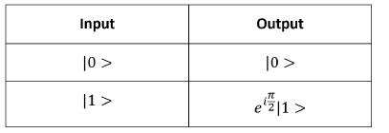
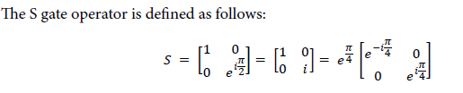

The S gate
The S gate applies a𝜋/2 (90°) rotation to the input state around the z axis of the Bloch sphere. This means by the operation of the S gate we get a complex amplitude multiplied with the state |1> only.

Slide 24

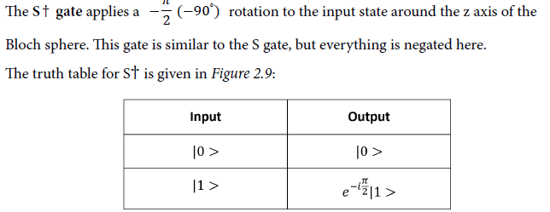

Slide 25
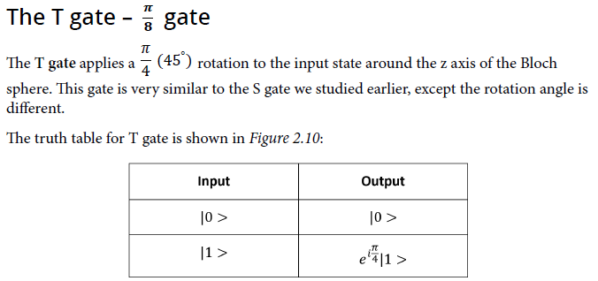

Slide 26
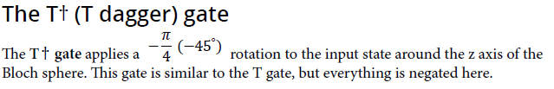
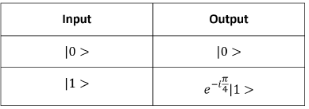
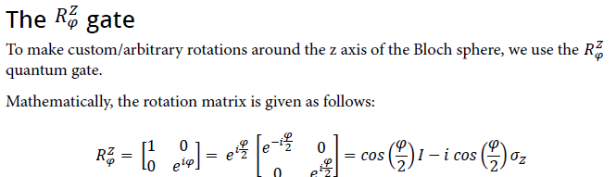

Slide 27
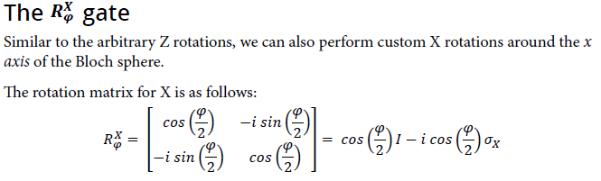
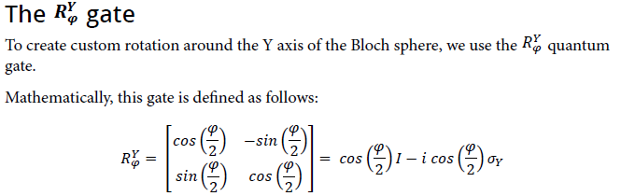

Slide 28
THANK YOU

